Slide 1
WEB & Mobile Application development
Module – 01
CSS Class 06
Saylani Mass IT Training Faisalabad
Instructor : Umair Azmat
WhatsApp : +923217061116

Slide 2
The position Property
The position property in CSS tells about the method of positioning for an element or an HTML entity. There are five different types of position property available in CSS:
Static
Fixed
Relative
Absolute
Sticky

Slide 3
CSS Positioning Elements
The positioning of an element can be done using the top, right, bottom, and left properties.
These specify the distance of an HTML element from the edge of the viewport.
To set the position by these four properties, we have to declare the positioning method.
They also work differently depending on the position value.

Slide 4
CSS Flexbox
The flexbox or flexible box model in CSS is a one-dimensional layout model
IT has flexible and efficient layouts with distributed spaces among items to control their alignment structure
ie., it is a layout model that provides an easy and clean way to arrange items within a container.
Flexbox can be useful for creating small-scales layouts & is responsive and mobile-friendly.
Flex Container
Flex Items
Flex Direction

Slide 5
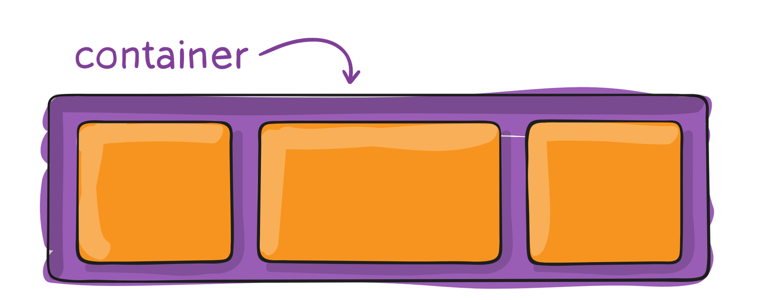
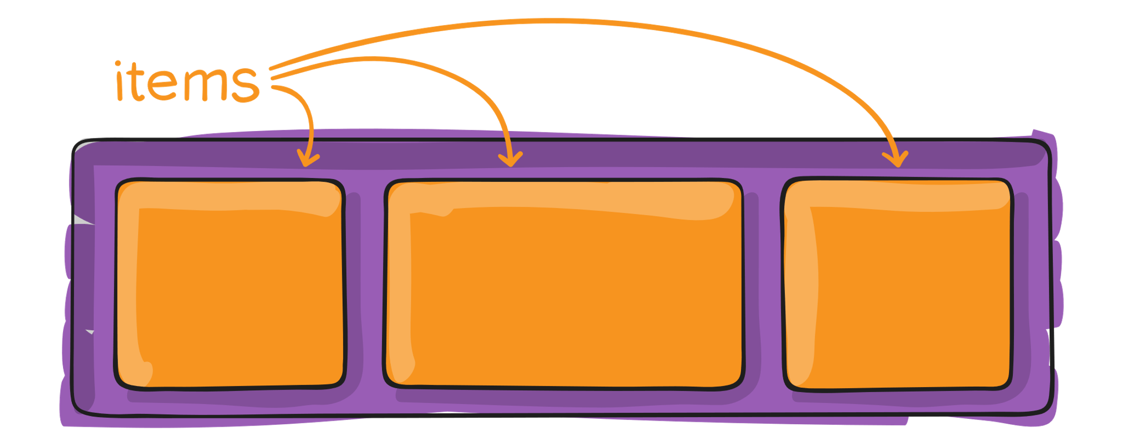
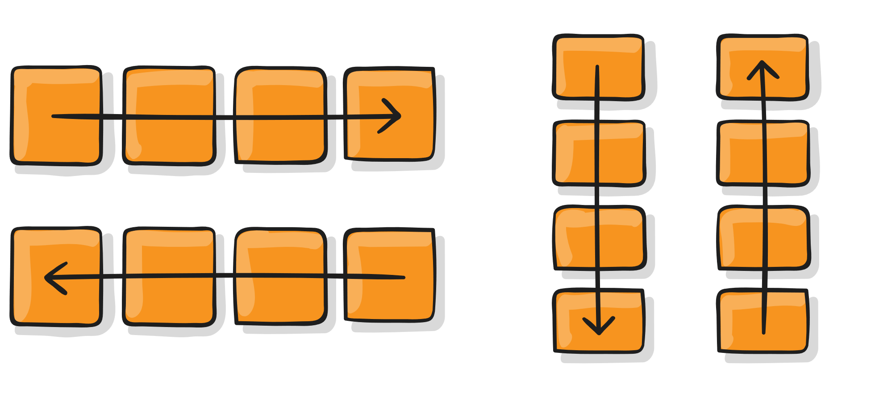
CSS Flex-Box

Slide 6
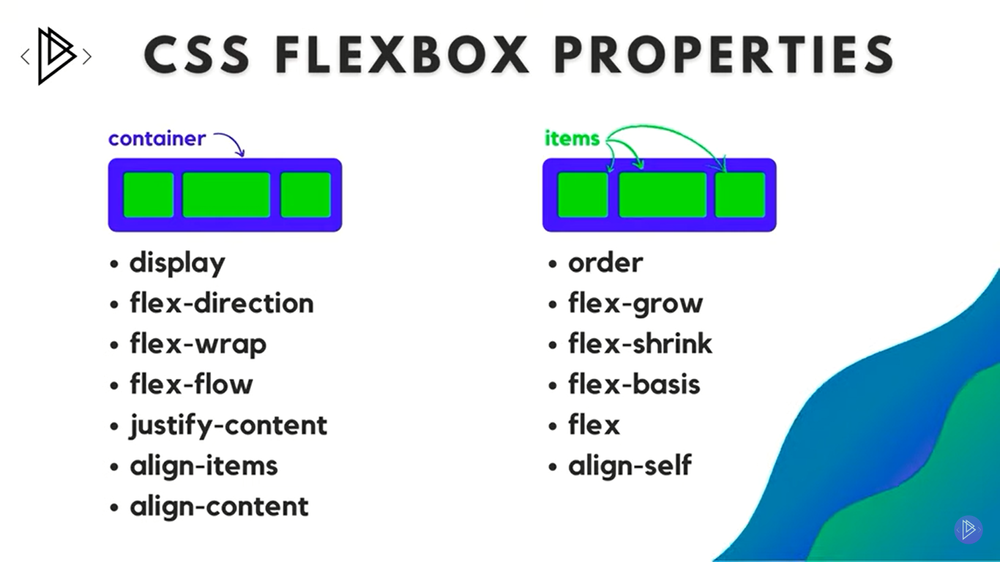
CSS Flex-Box

Slide 7
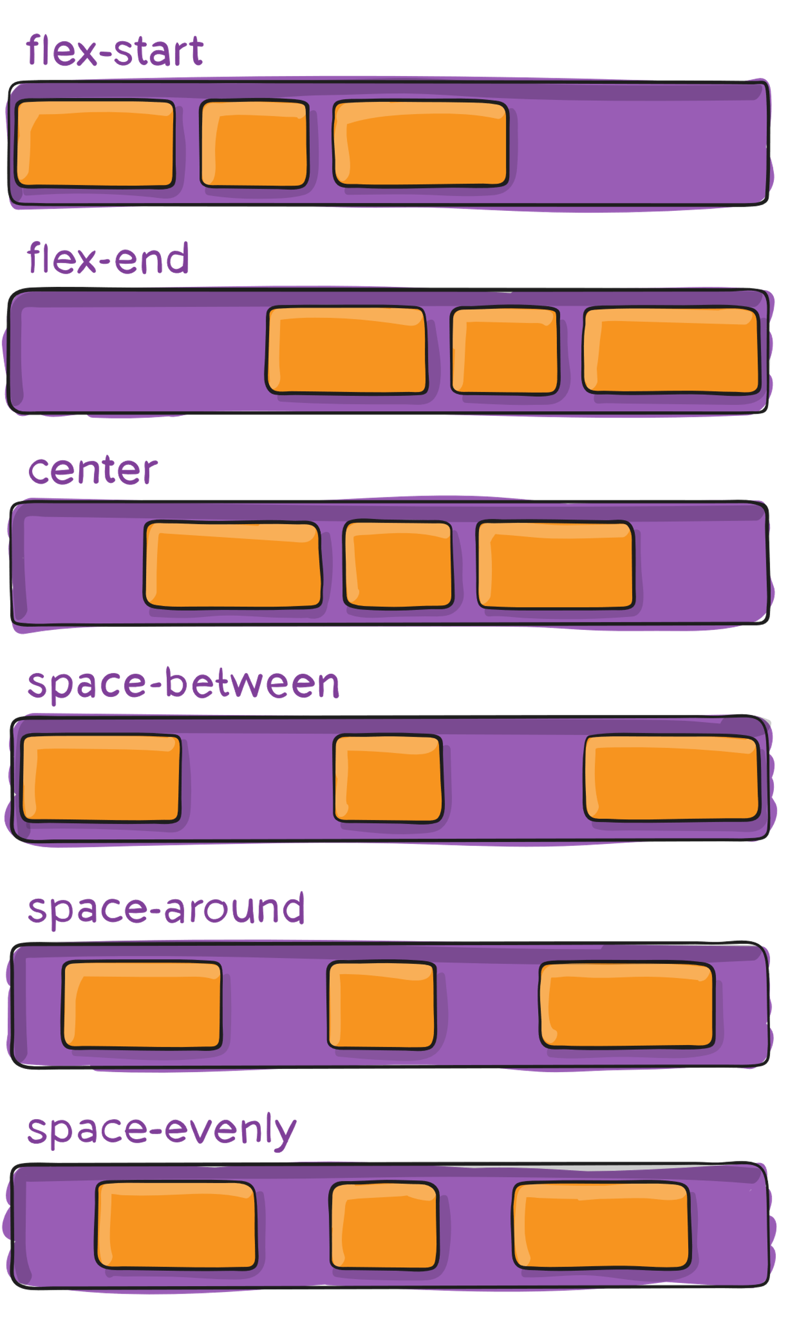
Justify-Content

Slide 8
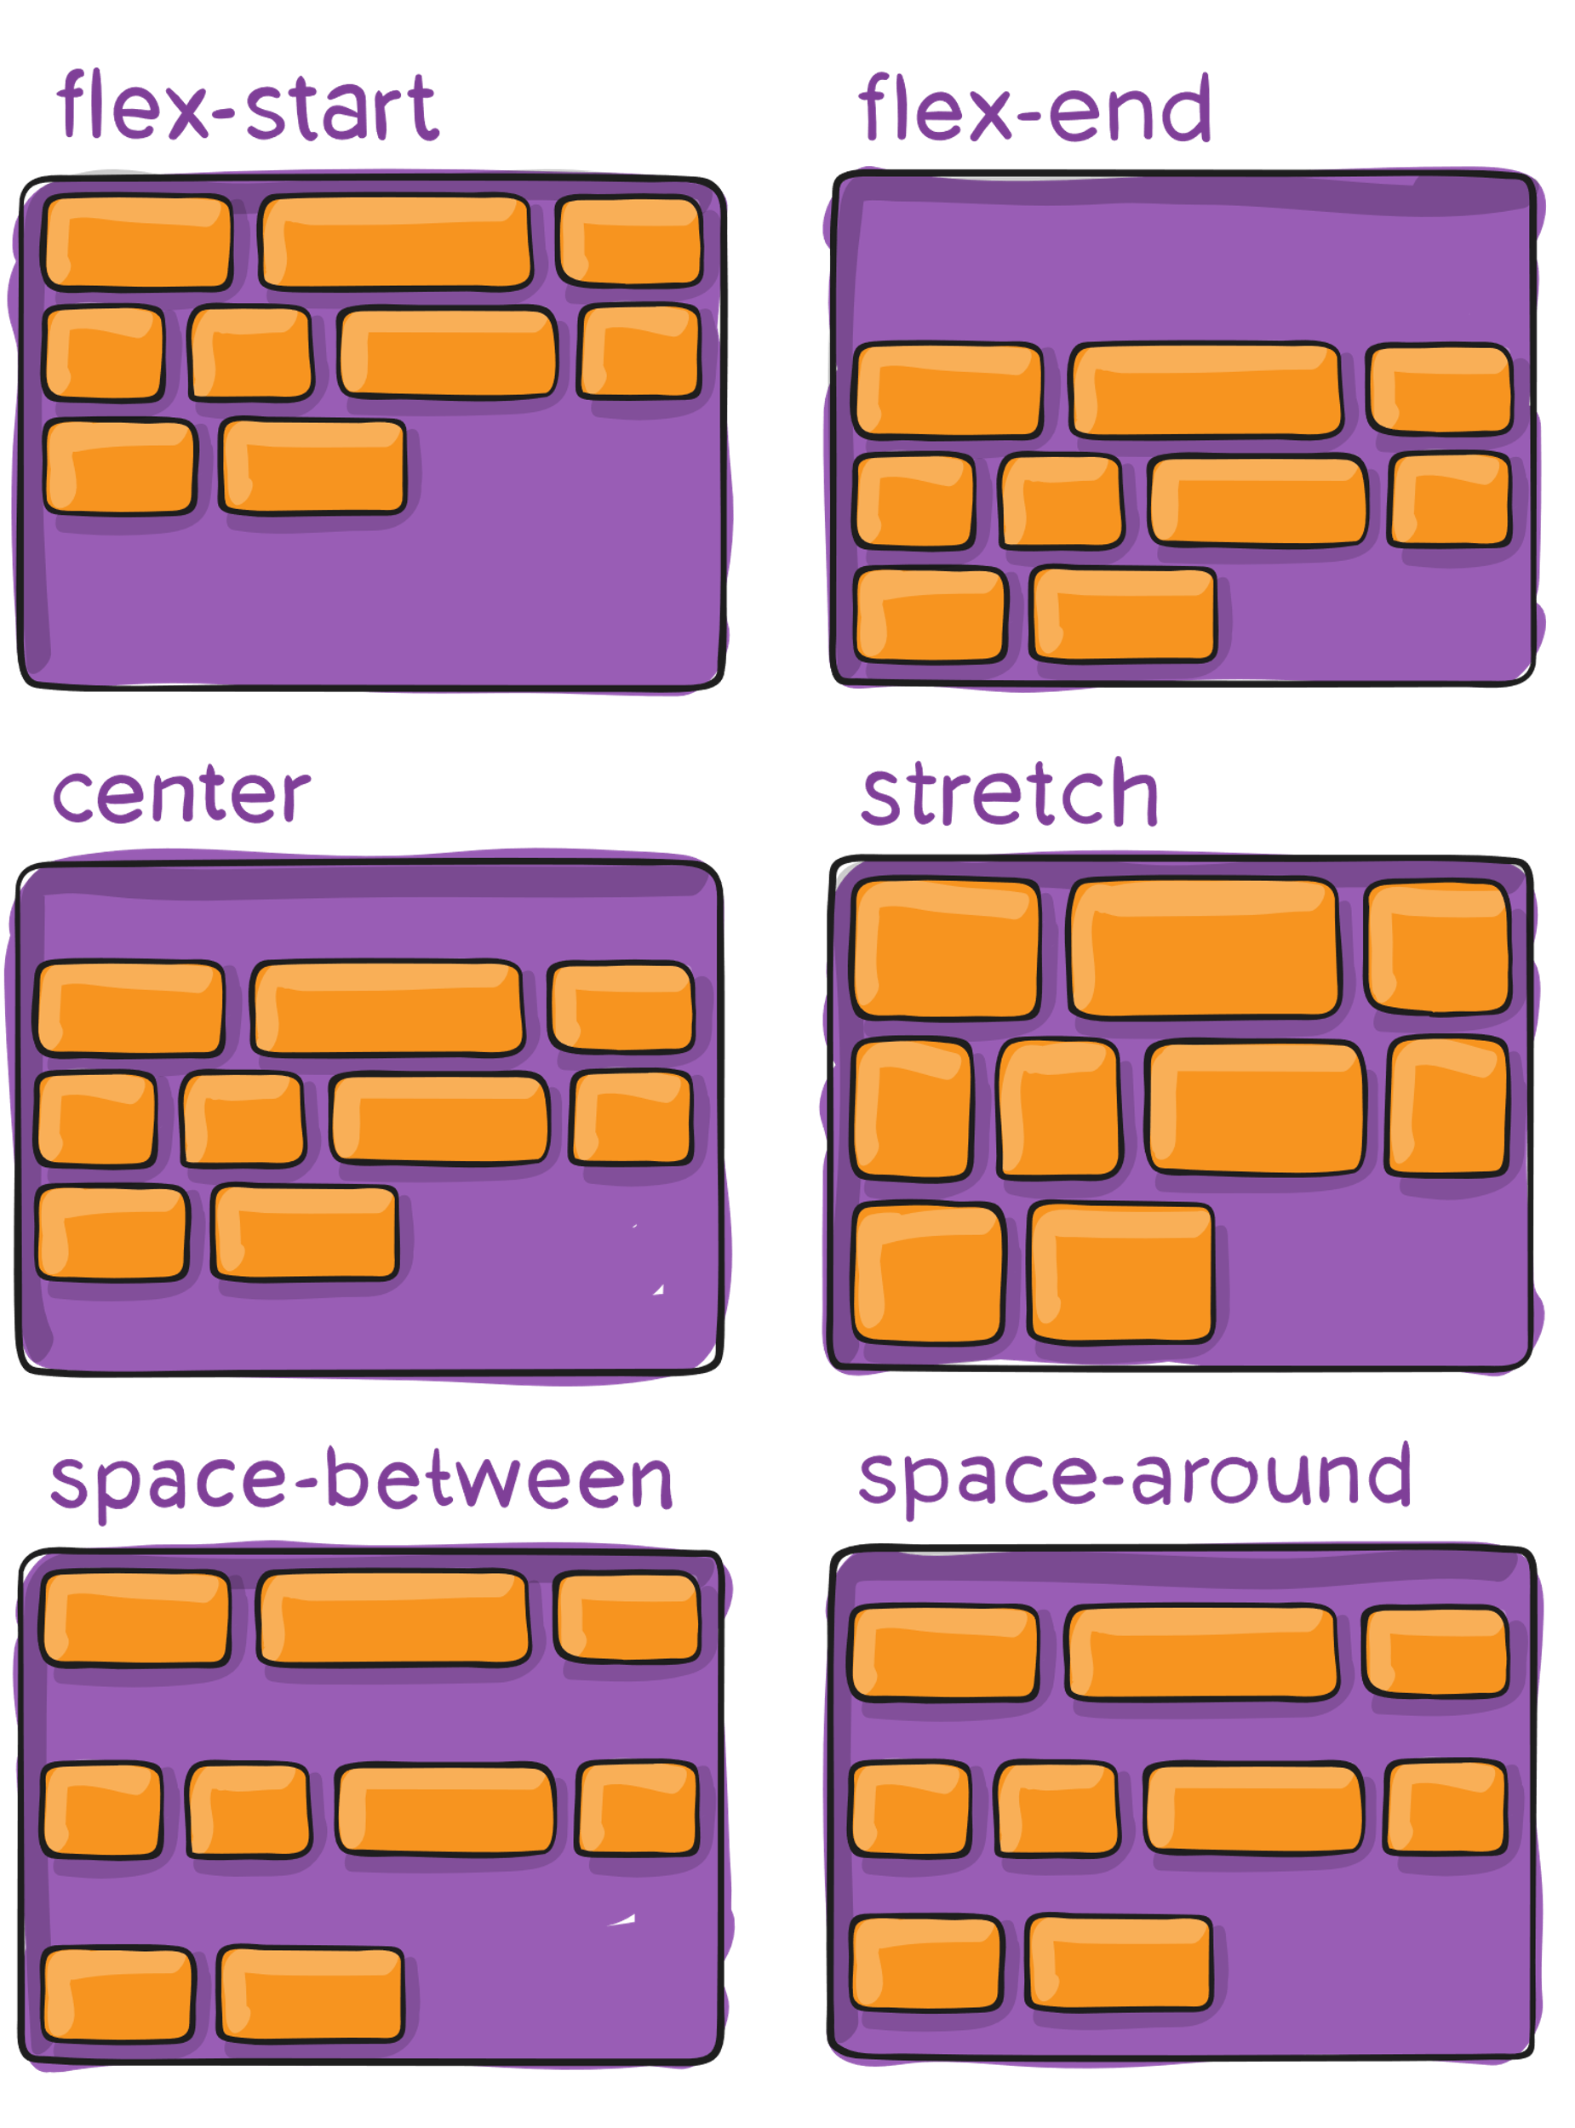

Slide 9
Flex Container
Display flex
Flex Direction (row,row-reverse,column,col-revers)
Flex-wrap (wrap,wrap-reverse)
Flex-flow Shorthand Property (direction,wrap)
Justify-Content (center , flex-end , flex-start, space-between , space-around)
Align-item {vertically} (center , flex-end , flex-start)
Align-Content (space-between , space-around)

Slide 10
Flex Container
Order
Flex-grow (by default 0)
Flex-shrink (by default 1)
Flex (grow , shrink , basis)

Slide 11
Flex Item
Flex grow (number)
Flex-shrink ()
Order (number)
Align-self (center)
Flex-Box Froggy

Slide 12
Media Quries
@media (min-width:0px) and (max-width:414px) {
}

